Slide 1

Cosmos DB Performance Tuning
Mike Benkovich
Microsoft Azure MVP
mike@benko.com | www.benkoTIPS.com | @mbenko

Slide 2





Visit the Sponsor Booths
Lots of Great Raffle Prizes!
Enter your details on Raffle Entry Form & visit Sponsors to fill in Bingo card for Raffle prizes
Thank you Sponsors!
Gold Sponsors:
Silver Sponsors:
Blog Sponsors:
Notes:
Link to Raffle: https://forms.office.com/r/ZMSNL0Bbpp

Slide 3




PASSMN – News/Info
Thanks to all our sponsors of 2024!
We need Speakers & Sponsors for 2025 PASSMN Meetings!
Sign up to present at one of the monthly meetings!
Monthly Meetup: 3rd Tuesday of Each Month
Signup on Meetup:
https://www.meetup.com/MN-SQL-Server-User-Group-PASSMN/
Board Member Elections in Q4:
Your chance to help the MN Data/SQL Community!
https://forms.office.com/r/rWfPhV6Chd

Slide 4


Connect, share, & learn with peers and thought leaders while celebrating all things data for a week of learning and networking opportunities.
November 4th Through November 8th in Seattle, WA
https://passdatacommunitysummit.com/

Slide 5



Mike Benkovich
- Enterprise Cloud Architect & Consultant
- Live in Minneapolis
- Founder of Imagine Technologies, Inc.
- Developing Courses for LinkedIn Learning
- Blog www.benkoTIPS.com
- Follow @mbenko on Twitter
Send me Feedback! mike@benko.com
- Azure Office Hours on Fridays! https://bit.ly/BnkAzHrs

Slide 6
Mike Benkovich
- Developer
- Cloud Architect & Consultant
- Live in Minneapolis
- Founder of Imagine Technologies, Inc.
- Developing Courses for LinkedIn Learning
- Blog www.benkoTIPS.com
- Follow @mbenko on Twitter
- Send me Feedback! mike@benkotips.com

Slide 7
What we’ll cover today
Why Cosmos
Provisioning Cosmos
Working with Data
Data Modeling Strategies
Performance and tuning

Slide 8



Cosmos DB 101
Core (SQL)
MongoDB
Table API
Column-family
Document
Key-value
Graph
Guaranteed low latency at the 99th percentile
Elastic scale out
of storage & throughput
Five well-defined consistency models
Turnkey global distribution
Comprehensive SLAs

Slide 9
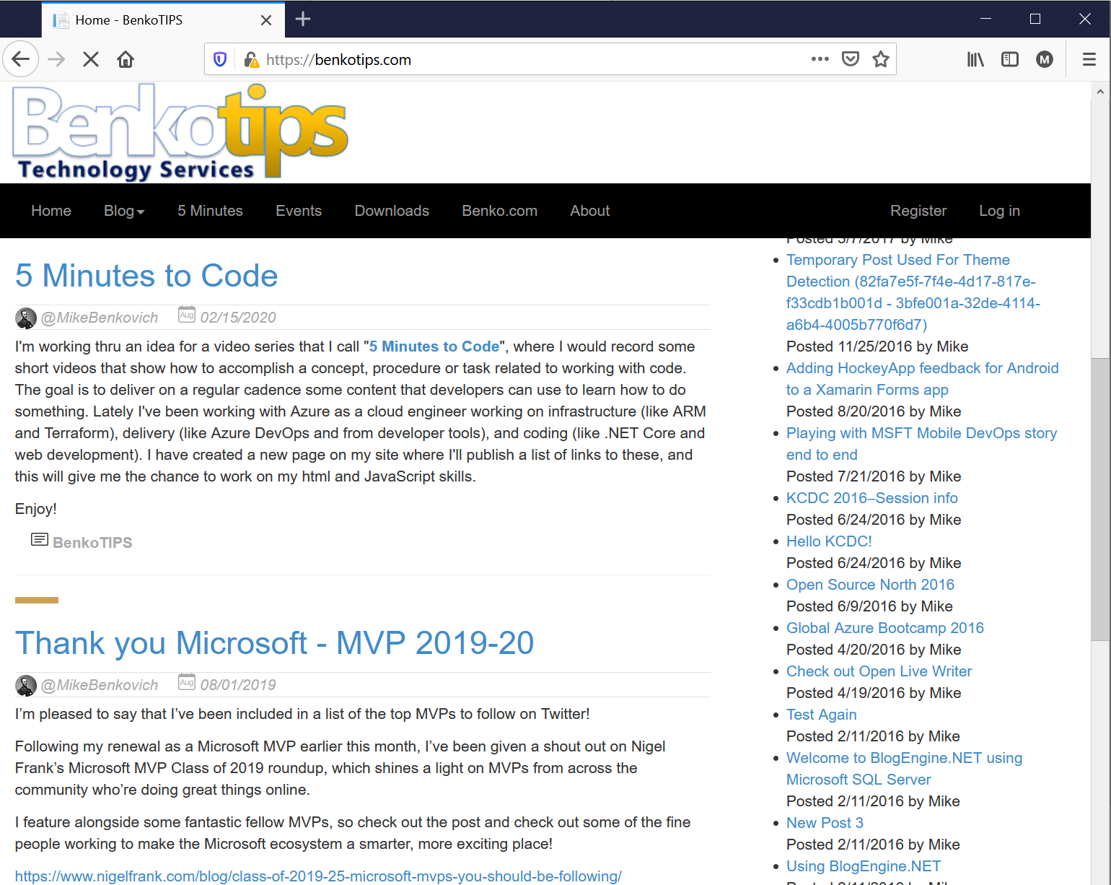
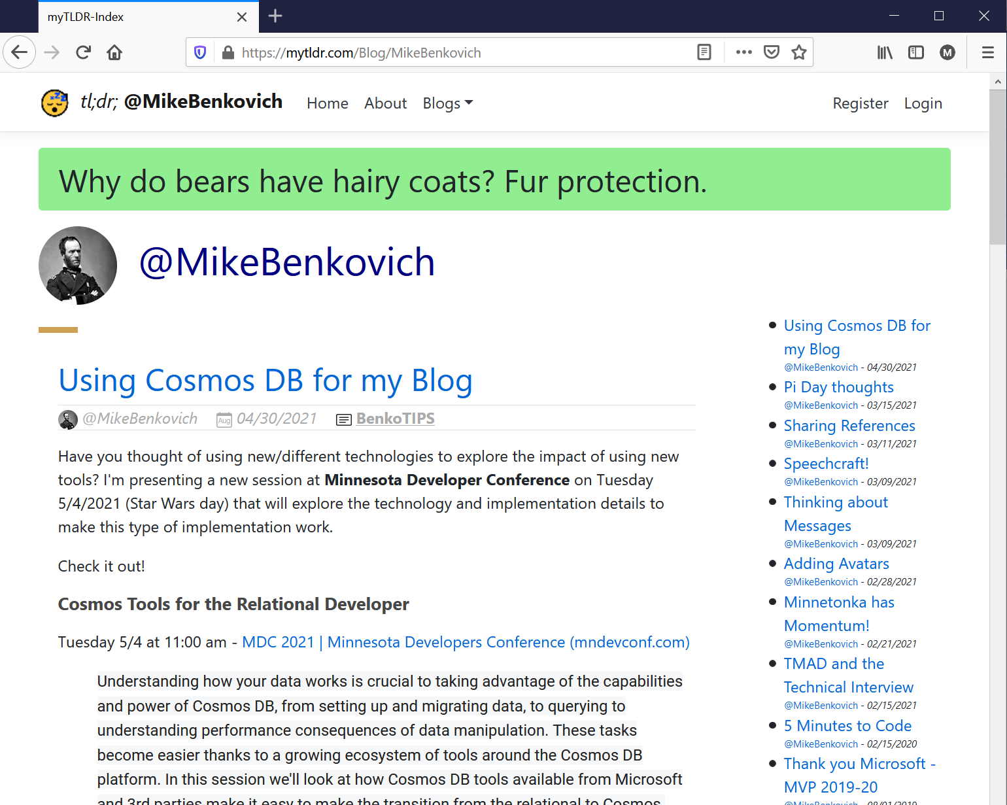
Scenario: BenkoTIPS is going Global!
Want to Re-host my Blog
Azure App Services
Traffic Manager routing
.NET 8+
Data…?

Slide 10
Cosmos DB Overview
A Simple Global Assigned NoSQL Database that can be replicated across regions with a click of a button
High Scalability and Availability
Guaranteed low latency and provisioned performance
Multi-model Multi-API
Configurable Consistency Options

Slide 11
Session’s objectives
Better understand modeling and partitioning on Cosmos DB
Model a real-world example
Maximize performance and scalability
Appreciate how it differs from relational modeling

Slide 12
Containers and Documents
{
"id": "a40d0078",
"Title": "Add stuff to the Queue",
"Description": null,
“Type": “Chore",
"Owner": null,
"IsDone": false,
"CreatedAt": "2019-09-05T11:40:12.4466765Z",
"CompleteAt": null,
"_rid": "vr0UAPQ9W4sDAAAAAAAAAA==",
"_self": "dbs/vr0UAA==/colls/...",
"_etag": "\"38001cae-0000-0300-0000-5d70...",
"_attachments": "attachments/",
"_ts": 1567683617
}
Database as collection of Documents in Containers
Provisioned performance – RU’s
Stored as JSON Document
Document Explorer (portal)
Storage Explorer
Supports multiple Record Types in Containers
No referential rules or constraints
No enforcement of data types

Slide 13
Some Terminology
RELATIONAL
Database
Table(s), View(s)
Row
Column
Foreign Key
Join
Sharding Key
COSMOS DB (SQL API)
Account/Database
Container/Collection
Item/Document (JSON)
Property
Reference
Embedded Document
Partition Key

Slide 14
What we’ll cover today
Why Cosmos
Provisioning Cosmos
Code patterns & tools
Data Modeling Strategies
Performance and tuning

Slide 15
Provisioning Cosmos
Selecting the API : SQL, Mongo, Cassandra, Gremlin, Table
Capacity model : Provisioned vs Serverless
Geo-Redundancy and Multi-region Writes
Networking
Backup
Encryption

Slide 16
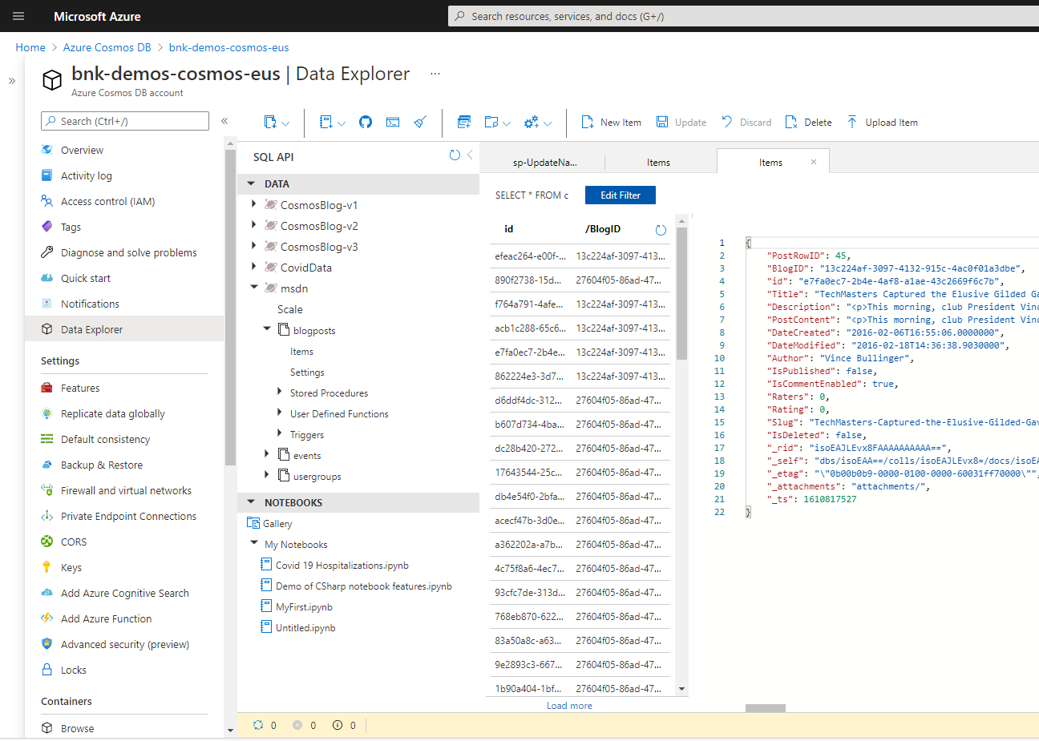
Get Started with Cosmos

Slide 17
What we’ll cover today
Why Cosmos
Provisioning Cosmos
Working with Data
Data Modeling Strategies
Performance and tuning

Slide 18
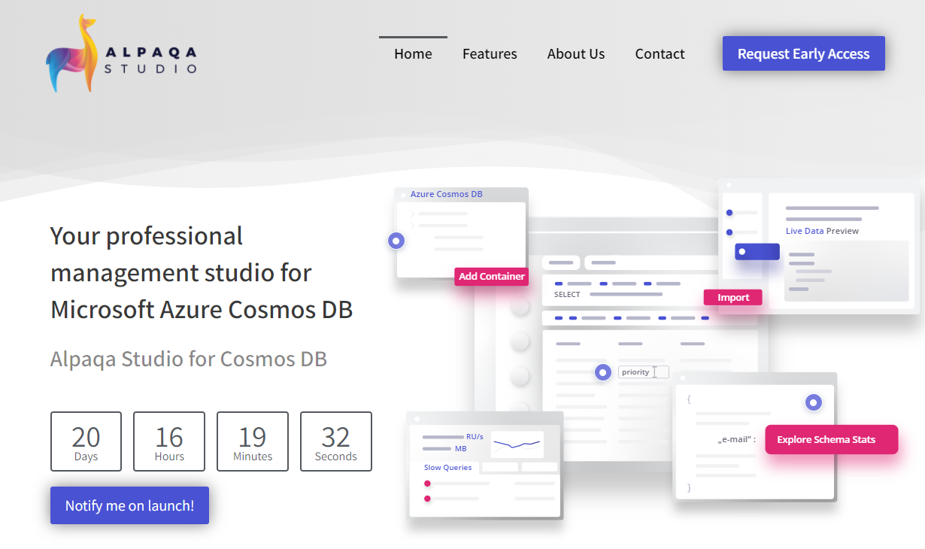
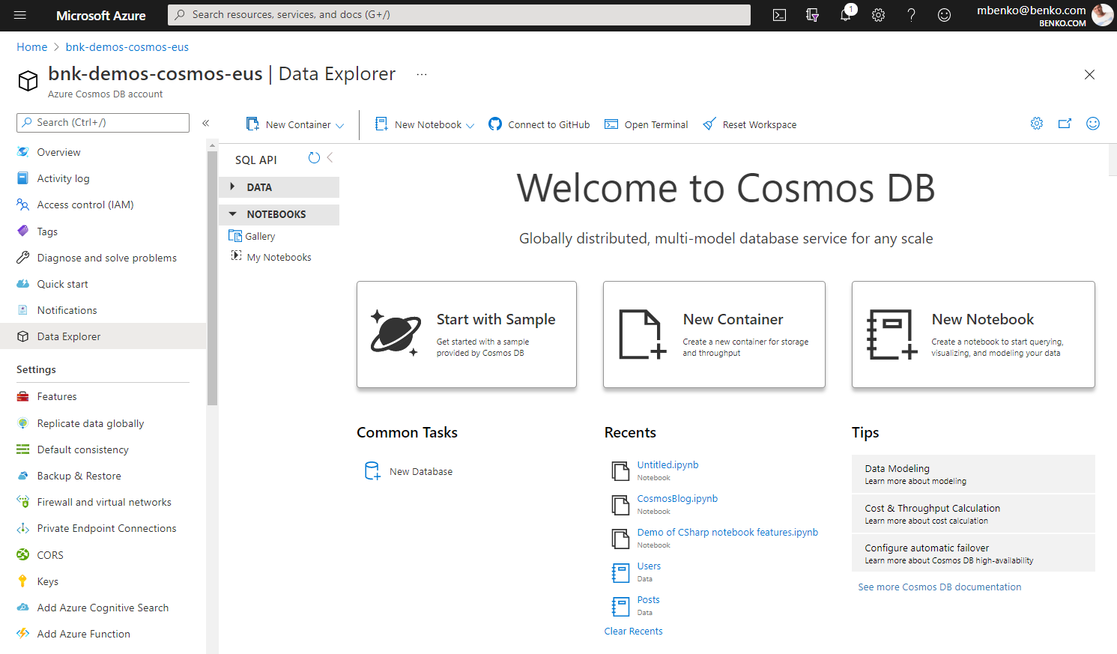
Tools to work with Cosmos Data
Azure Portal
Data Explorer
Jupyter Notebooks
Alpaqa Studio
Editing Data (in place and bulk)
Explore Schema
Background task engine
SDK – Code
https://alpaqastudio.com
Alpaqa Studio - The IDE for Cosmos DB (preview)

Slide 19
What we’ll cover today
Why Cosmos
Provisioning Cosmos
Working with Data
Data Modeling Strategies
Performance and tuning

Slide 20
Provisioned Performance
Expected performance has to be provisioned
Expressed in Request Units per second (RU/s)
Represents the "cost" of a request in terms of CPU, memory and I/O
Performance can be provisioned:
at the database-level
at the collection-level
Provisioned performance can be changed programmatically with API calls

Slide 21


The rules of the game: partitioning
Cosmos DB achieves horizontal scalability by partitioning your data

Slide 22

The rules of the game: partitioning
Cosmos DB achieves horizontal scalability by partitioning your data
'userId': 'abc'
'userId': 'def'
'userId': 'ghi'
logical partitions
Logical partitions group your data according to the collection's partition key
Notes:
- Logical partitions are shuffled across physical servers, that’s how we scale out

Slide 23
The rules of the game: partitioning
A good partition key ensures well-balanced partitions
Both in terms of storage and in terms of throughput
Ideally, read queries should get all their results from one partition
'userId': 'abc'
'userId': 'def'
'userId': 'ghi'
SELECT * FROM u WHERE u.userId = 'def'

Slide 24




Scenario: Rehost Blog in Cosmos
Login Page
- Login as user - Link: Register user
Register Page
- Create new user
Users can create posts. Users can also like and add comments to posts.
A front page displays a feed of recently created posts. It is possible to list all posts for a particular user. It is also possible to list all comments of a post and all users who have liked a post.
Blog Page
- Feed top posts - Filter: by Author
- Link: Login - Link: Post Detail - Link: Create Post
A post is displayed with its author's username and a count of comments and likes. Comments and likes are also displayed with the username of their authors.
Post Detail Page
- Post content
- Link: Posts by author
- Link: Like Post - Link: Add comment
Create/Edit Post
- Post content
When displayed as lists, posts only present a truncated summary of their content.
Notes:
Background image from 5ad47aae12355d55c86bcb408d88ba08.jpg (1920×800) (pinimg.com)

Slide 25
Start by identifying the access patterns
What are the requests that our design will have to serve?
To make it easier to follow, categorize them as:
Command (write request)
Query (read-only request)
Think in terms of data navigation

Slide 26

Start by identifying the access patterns
Login Page
- Login as user - Link: Register user
Register Page
- Create new user
[C1] Create/edit a user's profile
[Q1] Retrieve a user's profile
[C2] Create/edit a post
[Q2] Retrieve a post
[Q3] List a user's posts in short form
[C3] Create a comment
[Q4] List a post's comments
[C4] Like a post
[Q5] List a post's likes
[Q6] List the x most recent posts in short form (feed)
Blog Page
- Feed top posts - Filter: by Author
- Link: Login - Link: Post Detail - Link: Create Post
Post Detail Page
- Post content
- Link: Posts by author
- Link: Like Post - Link: Add comment
Create/Edit Post
- Post content
Notes:
- This is going to be the test suite that we will execute against our data model each time we update the design

Slide 27
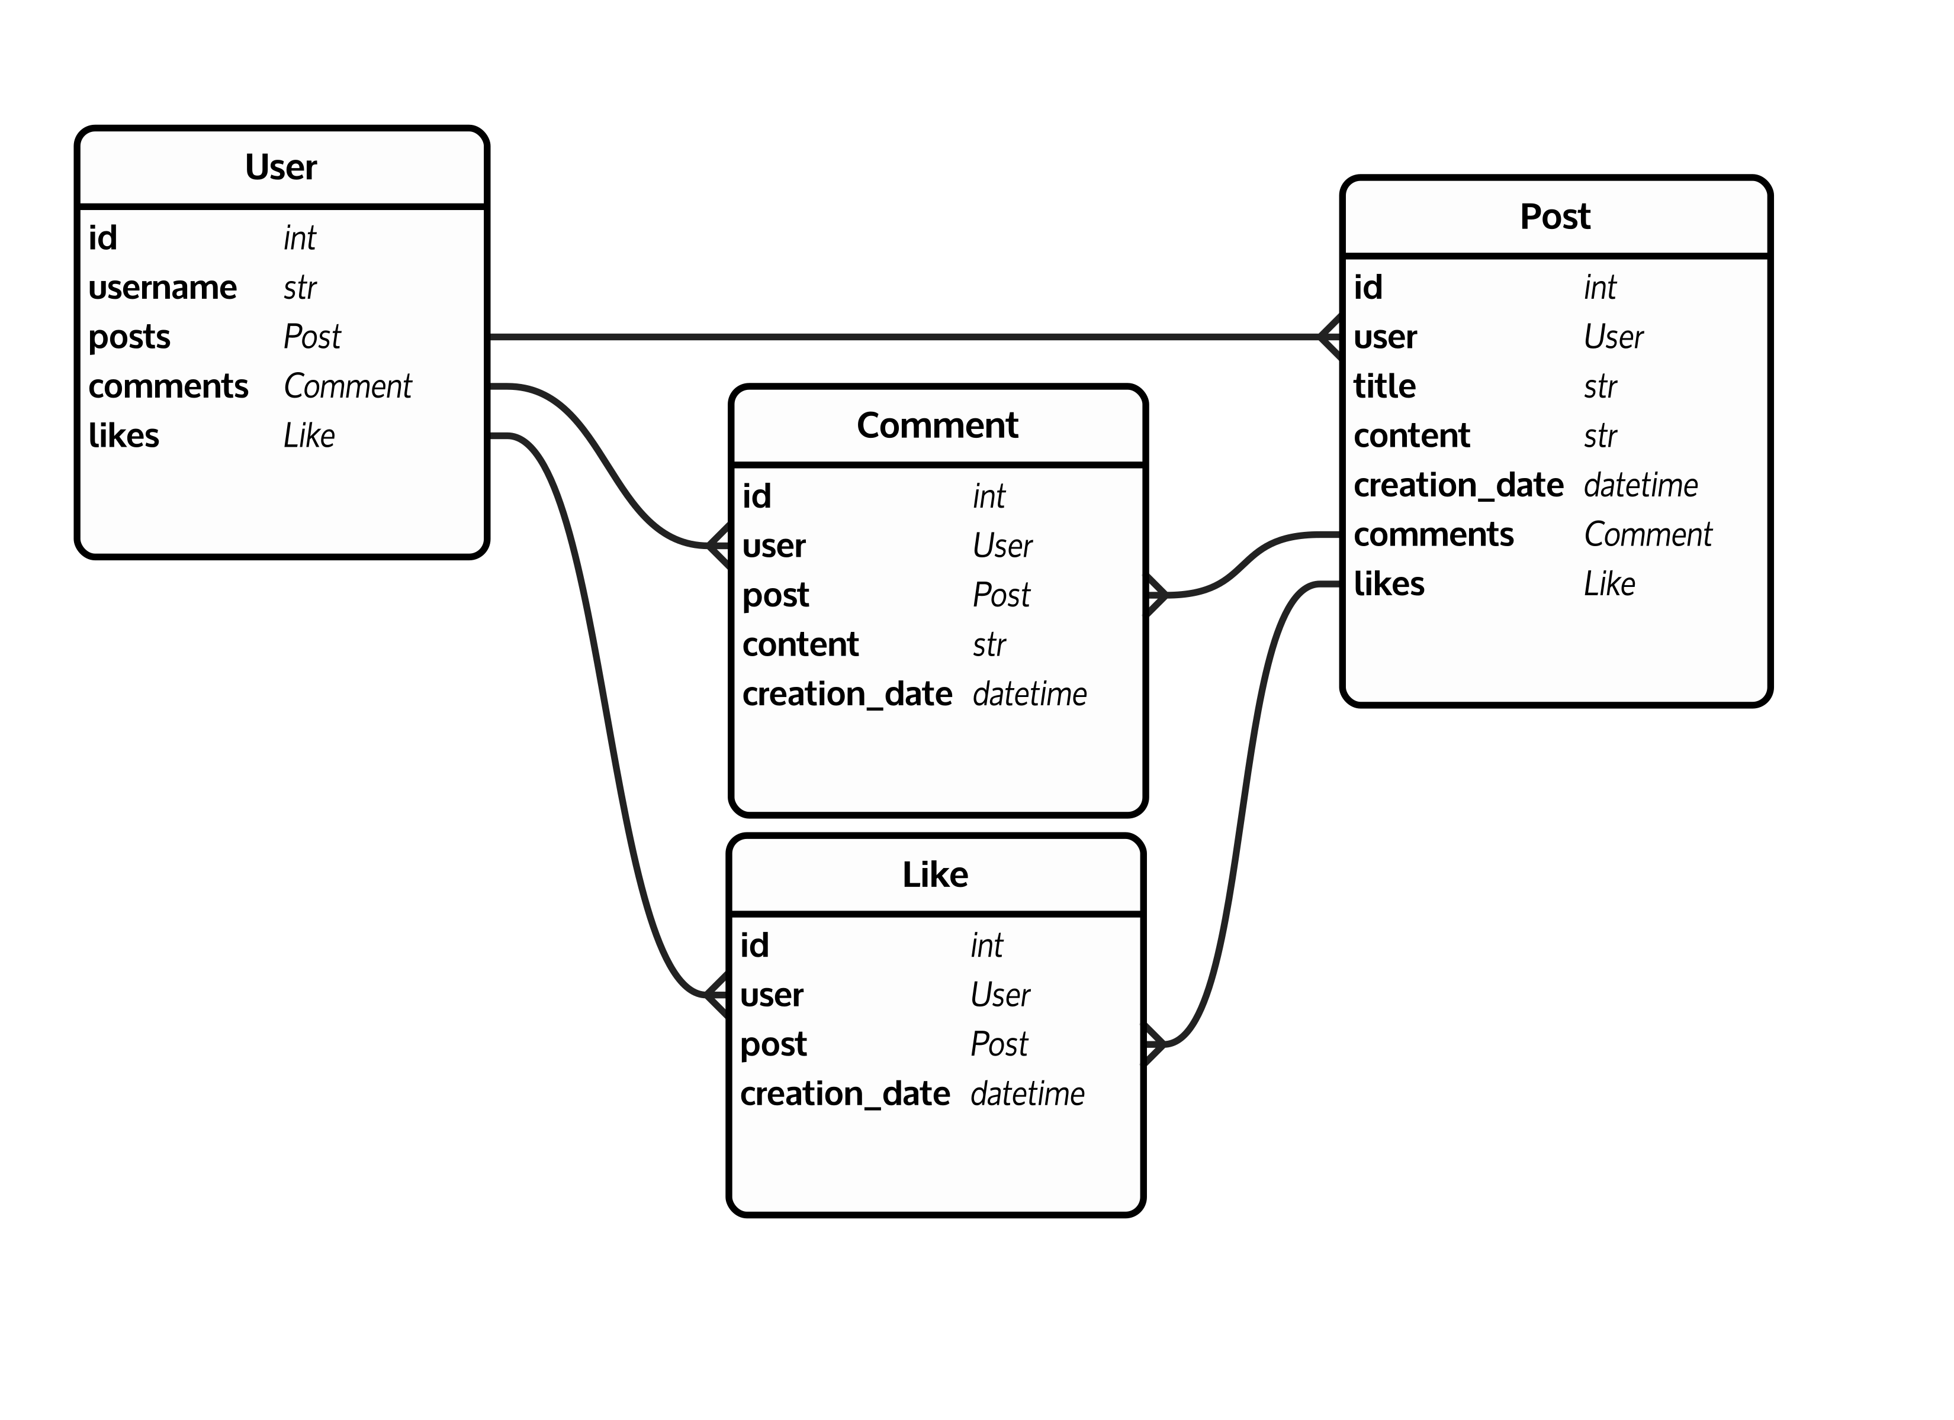
Maybe you instantly think about…
Notes:
- Tackle the exercise with a virgin mind, try to forget how you usually model data

Slide 28
The rules of the game: data model
NO
In a Cosmos DB database, we store documents in collections
like rows in a table?
NO
user
post
comment
like
users
posts
comments
likes

Slide 29
The rules of the game: data model
In a Cosmos DB database, we store documents in collections
user
post
comment
like
users
posts

Slide 30
The rules of the game: data model
NO
In a Cosmos DB database, we store documents in collections
like rows in a table?
NO
user
post
comment
like
users
posts
comments
likes

Slide 31
V1: a first shot
{
"id": "<comment-id>",
"postId": "<post-id>",
"userId": "<comment-author-id>",
"content": "<comment-content>",
"creationDate": "<comment-creation-date>"
}
{
"id": "<user-id>",
"username": "<user-username>"
}
{
"id": "<post-id>",
"userId": "<post-author-id>",
"title": "<post-title>",
"content": "<post-content>",
"creationDate": "<post-creation-date>"
}
{
"id": "<like-id>",
"postId": "<post-id>",
"userId": "<liker-id>",
"creationDate": "<like-creation-date>"
}
Notes:
- Blue highlights: we chose to reference related items instead of embedding them

Slide 32
To embed or to reference?
Embed when:
1:1
1:few
Items queried together
Items updated together
Reference when:
1:many (unbounded)
Many:many
Items updated independently

Slide 33
To embed or to reference?
{
"id": "…",
"relatedItem": {
"relatedData": "…"
}
}
{
"id": "…",
"relatedItemId": "<related-item-id>"
}
{
"id": "<related-item-id>",
"relatedData": "…"
}

Slide 34
V1: a first shot
{
"id": "<user-id>",
"username": "<user-username>"
}
users
PK: id
{
"id": "<post-id>",
"type": "post",
"postId": "<post-id>",
"userId": "<post-author-id>",
"title": "<post-title>",
"content": "<post-content>",
"creationDate": "<post-creation-date>"
}
{
"id": "<comment-id>",
"type": "comment",
"postId": "<post-id>",
"userId": "<comment-author-id>",
"content": "<comment-content>",
"creationDate": "<comment-creation-date>"
}
{
"id": "<like-id>",
"type": "like",
"postId": "<post-id>",
"userId": "<liker-id>",
"creationDate": "<like-creation-date>"
}
posts
PK: postId
Notes:
- The ‘posts’ container is partitioned by postId, which means that each logical partition will contain 1 post + all of its comments + all of its likes

Slide 35
How well does our model perform?
Benchmarked against a dummy dataset
100,000 users
5 – 50 posts / user
0 – 25 comments / post
0 – 100 likes / post
users
posts
100 GB
100k docs
95+M docs

Slide 36

Create/edit a user’s profile
C1
Q1
C2
users
Q2
Q3
PK: id
C3
Q4
posts
C4
Q5
PK: postId
Q6
7 ms / 5.71 RU

Slide 37
Retrieve a user's profile
C1
Q1
C2
users
Q2
SELECT * FROM u WHERE u.id = '<user-id>'
Q3
PK: id
C3
Q4
posts
C4
Q5
PK: postId
Q6
3 ms / 2.90 RU

Slide 38
Create/edit a post
C1
Q1
C2
users
Q2
Q3
PK: id
C3
Q4
posts
C4
Q5
PK: postId
Q6
9 ms / 8.76 RU

Slide 39

Retrieve a post
C1
SELECT u.username FROM u
WHERE u.id = '<post-author-id>'
Q1
C2
SELECT * FROM p
WHERE p.postId = '<post-id>'
AND p.type = 'post'
users
Q2
Q3
PK: id
C3
SELECT COUNT(1) FROM p
WHERE p.postId = '<post-id>'
AND p.type = 'comment'
Q4
posts
C4
SELECT COUNT(1) FROM p
WHERE p.postId = '<post-id>'
AND p.type = 'like'
Q5
PK: postId
Q6
9 ms / 19.54 RU

Slide 40

List a user's posts in short form
C1
SELECT u.username FROM u
WHERE u.id = '<post-author-id>'
Q1
C2
SELECT * FROM p
WHERE p.userId = '<author-id>'
AND p.type = 'post'
users
Q2
Q3
PK: id
C3
SELECT COUNT(1) FROM p
WHERE p.postId = '<post-id>'
AND p.type = 'comment'
Q4
posts
C4
SELECT COUNT(1) FROM p
WHERE p.postId = '<post-id>'
AND p.type = 'like'
Q5
PK: postId
Q6
130 ms / 619.41 RU

Slide 41
Create a comment
C1
Q1
C2
users
Q2
Q3
PK: id
C3
Q4
posts
C4
Q5
PK: postId
Q6
7 ms / 8.57 RU

Slide 42
List a post's comments
C1
Q1
C2
SELECT * FROM p
WHERE p.postId = '<post-id>'
AND p.type = 'comment'
users
Q2
Q3
PK: id
C3
SELECT u.username FROM u
WHERE u.id = '<comment-author-id>'
Q4
posts
C4
Q5
PK: postId
Q6
23 ms / 27.72 RU

Slide 43
Like a post
C1
Q1
C2
users
Q2
Q3
PK: id
C3
Q4
posts
C4
Q5
PK: postId
Q6
6 ms / 7.05 RU

Slide 44
List a post's likes
C1
Q1
C2
SELECT * FROM p
WHERE p.postId = '<post-id>'
AND p.type = 'like'
users
Q2
Q3
PK: id
C3
SELECT u.username FROM u
WHERE u.id = '<liker-id>'
Q4
posts
C4
Q5
PK: postId
Q6
59 ms / 58.92 RU

Slide 45
List the x most recent posts in short form (feed)
C1
SELECT TOP <x> * FROM p
WHERE p.type = 'post'
ORDER BY p.creationDate DESC
Q1
C2
SELECT u.username FROM u
WHERE u.id = '<post-author-id>'
users
Q2
Q3
PK: id
C3
SELECT COUNT(1) FROM p
WHERE p.postId = '<post-id>'
AND p.type = 'comment'
Q4
posts
C4
SELECT COUNT(1) FROM p
WHERE p.postId = '<post-id>'
AND p.type = 'like'
Q5
PK: postId
Q6
306 ms / 2063.54 RU

Slide 46
Cost in RU’s
C1
Create/edit a user’s profile
5.71 RU
Q1
Retrieve a user’s profile
2.90 RU
C2
Create/edit a post
8.76 RU
Q2
Retrieve a post
19.54 RU
Q3
List a user’s post in short form
619.41 RU
C3
Create a comment
8.57 RU
Q4
List a post’s comments
27.72 RU
C4
Like a post
7.05 RU
Q5
List a post’s likes
58.92 RU
Q6
List the x most recent posts in short form (feed)
2,063.54 RU

Slide 47
What we’ll cover today
Why Cosmos
Provisioning Cosmos
Working with Data
Data Modeling Strategies
Performance and tuning

Slide 48
V1: performance issues
Having to issue multiple queries to handle a single request
Issuing queries that don't filter on the partition key, leading to a partition scan

Slide 49
V2: introducing denormalization
users
PK: id
{
"id": "<post-id>",
"type": "post",
"postId": "<post-id>",
"userId": "<post-author-id>",
"userUsername": "<post-author-username>",
"title": "<post-title>",
"content": "<post-content>",
"commentCount": <number-of-comments>,
"likeCount": <number-of-likes>,
"creationDate": "<post-creation-date>"
}
{
"id": "<comment-id>",
"type": "comment",
"postId": "<post-id>",
"userId": "<comment-author-id>",
"userUsername": "<comment-author-username>",
"content": "<comment-content>",
"creationDate": "<comment-creation-date>"
}
{
"id": "<like-id>",
"type": "like",
"postId": "<post-id>",
"userId": "<liker-id>",
"userUsername": "<liker-username>",
"creationDate": "<like-creation-date>"
}
posts
PK: postId
Notes:
- Additional fields in bold

Slide 50
Denormalizing within the same logical partition with stored procedures
Written in Javascript
Scoped to a single logical partition
Executed as atomic transactions

Slide 51

Create a comment
C1
function createComment(postId, comment) {
var collection = getContext().getCollection();
collection.readDocument(
`${collection.getAltLink()}/docs/${postId}`,
function (err, post) {
post.commentCount++;
collection.replaceDocument(
post._self,
post,
function (err) {
comment.postId = postId;
collection.createDocument(
collection.getSelfLink(),
comment
);
}
);
});
}
Q1
C2
users
Q2
Q3
PK: id
C3
Q4
posts
C4
Q5
PK: postId
Q6

Slide 52



Denormalizing across logical partitions and containers with the change feed
Notes:
- Change feed can be consumed from an Azure Function or from a customer processor implemented on top of our SDKs

Slide 53
Denormalizing usernames into posts
function updateUsername(userId, username) {
var collection = getContext().getCollection();
collection.queryDocuments(
collection.getSelfLink(),
`SELECT * FROM p WHERE p.userId = '${userId}'`,
function (err, results) {
for (var i in results) {
var doc = results[i];
doc.userUsername = username;
collection.replaceDocument(
collection.getSelfLink(),
doc);
}
});
}
users
posts
Notes:
- In order not to limit readability and audience understanding, we miss an intermediate step here: stored procedures can only be executed against one partition, which means that we shall first list all the postId values with a query like “SELECT p.id FROM p WHERE p.type = ‘post’”, then execute the SP for each value

Slide 54
Retrieve a post
C1
SELECT * FROM p
WHERE p.postId = '<post-id>'
AND p.type = 'post'
Q1
C2
SELECT u.username FROM u
WHERE u.id = '<post-author-id>'
users
Q2
Q3
PK: id
C3
SELECT COUNT(1) FROM p
WHERE p.postId = '<post-id>'
AND p.type = 'comment'
Q4
posts
C4
SELECT COUNT(1) FROM p
WHERE p.postId = '<post-id>'
AND p.type = 'like'
Q5
PK: postId
Q6
3 ms / 5.40 RU

Slide 55
List a post's comments
C1
Q1
C2
SELECT * FROM p
WHERE p.postId = '<post-id>'
AND p.type = 'comment'
users
Q2
Q3
PK: id
C3
SELECT u.username FROM u
WHERE u.id = '<comment-author-id>'
Q4
Q4
posts
C4
Q5
PK: postId
Q6
4 ms / 7.72 RU

Slide 56
List a post's likes
C1
Q1
C2
SELECT * FROM p
WHERE p.postId = '<post-id>'
AND p.type = 'like'
users
Q2
Q3
PK: id
C3
SELECT u.username FROM u
WHERE u.id = '<liker-id>'
Q4
posts
C4
Q5
Q5
PK: postId
Q6
4 ms / 8.92 RU

Slide 57
List a user's posts in short form
C1
SELECT * FROM p
WHERE p.userId = '<author-id>'
AND p.type = 'post'
Q1
C2
SELECT u.username FROM u
WHERE u.id = '<post-author-id>'
users
Q2
Q3
PK: id
C3
SELECT COUNT(1) FROM p
WHERE p.postId = '<post-id>'
AND p.type = 'comment'
Q4
posts
C4
SELECT COUNT(1) FROM p
WHERE p.postId = '<post-id>'
AND p.type = 'like'
Q5
PK: postId
Q6
83 ms / 532.33 RU
Notes:
- That query does not perform well because it’s not executed against a container partitioned by userId; we already have such a container: users! So we will denormalize our posts to the users container

Slide 58
V3: denormalizing entire documents
users
PK: id
posts
PK: postId

Slide 59
V3: denormalizing entire documents
{
"id": "<post-id>",
"type": "post",
"userId": "<post-author-id>",
"userUsername": "<post-author-username>",
"title": "<post-title>",
"content": "<post-content>",
"commentCount": <number-of-comments>,
"likeCount": <number-of-likes>,
"creationDate": "<post-creation-date>"
}
{
"id": "<user-id>",
"type": "user",
"userId": "<user-id>",
"username": "<user-username>"
}
users
PK: userId
PK: id
posts
PK: postId

Slide 60
Denormalizing documents with the change feed
posts
if (type == 'post')
truncate content
users

Slide 61
List a user's posts in short form
C1
SELECT * FROM p
WHERE p.userId = '<author-id>'
AND p.type = 'post'
Q1
C2
users
Q2
Q3
PK: userId
C3
Q4
posts
C4
Q5
PK: postId
Q6
4 ms / 6.46 RU

Slide 62
List the x most recent posts in short form (feed)
C1
SELECT TOP <x> * FROM p
WHERE p.type = 'post'
ORDER BY p.creationDate DESC
Q1
C2
SELECT u.username FROM u
WHERE u.id = '<post-author-id>'
users
Q2
Q3
PK: id
C3
SELECT COUNT(1) FROM p
WHERE p.postId = '<post-id>'
AND p.type = 'comment'
Q4
posts
C4
SELECT COUNT(1) FROM p
WHERE p.postId = '<post-id>'
AND p.type = 'like'
Q5
PK: postId
Q6
9 ms / 16.97 RU
Notes:
- The “trick” here is that this request only has to return a limited dataset (say, 500 most recent posts), so all the results would fit in a single partition -> we will create an extra container just for that

Slide 63
V3: denormalizing entire documents
users
PK: userId
posts
PK: postId

Slide 64
V3: denormalizing entire documents
{
"id": "<post-id>",
"type": "post",
"userId": "<post-author-id>",
"userUsername": "<post-author-username>",
"title": "<post-title>",
"content": "<post-content>",
"commentCount": <number-of-comments>,
"likeCount": <number-of-likes>,
"creationDate": "<post-creation-date>"
}
users
PK: userId
feed
PK: type
posts
PK: postId

Slide 65
Denormalizing documents with the change feed
posts
if (type == 'post')
truncate content
users

Slide 66
Denormalizing documents with the change feed
posts
if (type == 'post')
truncate content
post-trigger:
truncate container
users
feed

Slide 67
List the x most recent posts in short form (feed)
C1
SELECT TOP <x> * FROM p
WHERE p.type = 'post'
ORDER BY p.creationDate DESC
Q1
users
C2
PK: id
Q2
Q3
posts
C3
Q4
PK: postId
C4
Q5
feed
Q6
9 ms / 16.97 RU
PK: type

Slide 68
Our final design
post
user
comment
post
users
post
posts
feed
like

Slide 69
Our final design
updateUsername()
users
posts
feed
if (type == 'user')
if (type == 'post')
truncate content

Slide 70
Denormalization can be added later
V1 was not that bad!
You can add denormalization later
The change feed is persistent
Run a one-time catch-up operation
Monitor your database performance and setup alerts
 | V1
C1 | 7 ms / 5.71 RU
Q1 | 3 ms / 2.90 RU
C2 | 9 ms / 8.76 RU
Q2 | 9 ms / 19.54 RU
Q3 | 130 ms / 619.41 RU
C3 | 7 ms / 8.57 RU
Q4 | 23 ms / 27.72 RU
C4 | 6 ms / 7.05 RU
Q5 | 59 ms / 58.92 RU
Q6 | 306 ms / 2063.54 RU

Slide 71
An overall look at performance
 | V1
C1 | 7 ms / 5.71 RU
Q1 | 3 ms / 2.90 RU
C2 | 9 ms / 8.76 RU
Q2 | 9 ms / 19.54 RU
Q3 | 130 ms / 619.41 RU
C3 | 7 ms / 8.57 RU
Q4 | 23 ms / 27.72 RU
C4 | 6 ms / 7.05 RU
Q5 | 59 ms / 58.92 RU
Q6 | 306 ms / 2063.54 RU
V2 | V3
7 ms / 5.71 RU | 7 ms / 5.71 RU
3 ms / 2.90 RU | 3 ms / 2.90 RU
9 ms / 8.76 RU | 9 ms / 8.76 RU
3 ms / 5.11 RU | 3 ms / 5.11 RU
28 ms / 201.54 RU | 4 ms / 6.46 RU
7 ms / 15.27 RU | 7 ms / 15.27 RU
4 ms / 7.72 RU | 4 ms / 7.72 RU
7 ms / 14.67 RU | 7 ms / 14.67 RU
4 ms / 8.92 RU | 4 ms / 8.92 RU
83 ms / 532.33 RU | 9 ms / 16.97 RU

Slide 72
What about the cost of denormalization?
We optimized for a read-heavy scenario
Reads >> writes
Q6 went from 2,000+ to 17 RUs (120x optimization)
Saved 1920 RUs by denormalizing posts at ~10 RUs / document
All depends on your specific scenario and access patterns

Slide 73
What else do you get?
Multi-model APIs
Flexibility of the change feed
Turnkey global distribution
Industry-leading SLA

Slide 74
Most importantly: what’s our scalability?
V3: limitless!
Performance will not depend on
number of documents
number of users
number of posts
Whether you have 10 or 10M users, query latency will always be the same
 | V3
C1 | 7 ms / 5.71 RU
Q1 | 3 ms / 2.90 RU
C2 | 9 ms / 8.76 RU
Q2 | 3 ms / 5.11 RU
Q3 | 4 ms / 6.46 RU
C3 | 7 ms / 14.67 RU
Q4 | 4 ms / 7.72 RU
C4 | 7 ms / 14.67 RU
Q5 | 4 ms / 8.92 RU
Q6 | 9 ms / 16.97 RU
Notes:
55:00 / 05:00

Slide 75
What we’ll cover today
Why Cosmos
Provisioning Cosmos
Working with Data
Data Modeling Strategies
Performance and tuning

Slide 76
Thanks to the following
Thomas Weiss presentation on Cosmos Performance in 2019
Alpaqa Studio
https://alpaqastudio.com
Jeff Widmer github code example of scenario
https://github.com/jwidmer/AzureCosmosDbBlogExample
Jane Chen - Cosmos Jupyter Notebooks
Mark Brown’s Cosmos TV
https://gotcosmos.com
James Serra’s Blog
https://www.jamesserra.com

Slide 77
Mike Benkovich
- Developer
- Cloud Architect & Consultant
- Live in Minneapolis
- Founder of Imagine Technologies, Inc.
- Developing Courses for LinkedIn Learning
- Blog www.benkoTIPS.com
- Follow @mbenko on Twitter
- Send me Feedback! mike@benkotips.com

Slide 78
Going further
Questions? I’m mike@benko.com - www.benkoTIPS.com
aka.ms/PracticalCosmosDB
cosmosdb.com
https://github.com/jwidmer/AzureCosmosDbBlogExample

